Slide 1
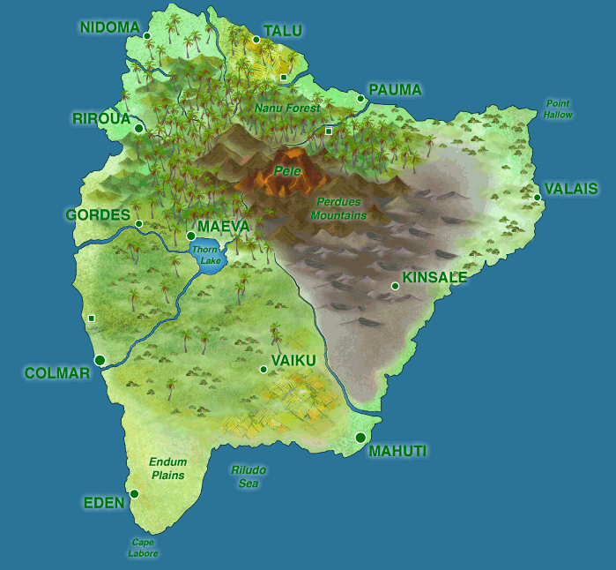
Out of the Classroom and Into the “Real” World: Learning Statistics by Doing Statistics with “The Islands”
Ann M. Brearley and Laura J. Le
Division of Biostatistics
University of Minnesota
Joint Statistical Meetings, Denver
July 31, 2019

Slide 2
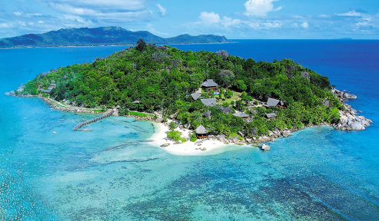
Outline
Our courses, students, and teaching approaches
The Islands – a brief tour
Islands Projects
Structure and timing
Example projects
Benefits and challenges
Where to get more info
Notes:
Goal: to make you think that this is the coolest teaching tool ever and you can’t wait to try it!

Slide 3


Our Courses and Students
Courses
Class Format:
Biostatistical Literacy (PubH 6414)
Biostatistics I & II (PubH 6450 & 6451)
Introduction to Clinical Trials (PubH 3415/7415)
In-person Online
&
Class Size:
Student Background
150
25
to
Students
PH graduate students
Health-related graduate students
Medical and PH professionals
Undergraduates interested in PH or medicine
Notes:
Student backgrounds
Graduate students in public health
Health-related graduate students (e.g. DNP, DVM) and trainees (e.g. residents, fellows)
Medical and public health professionals
Undergraduates interested in public health or medicine

Slide 4
Our Teaching Approaches
Goal: To make our courses (in-person and online) more active, relevant, and effective
Partially or fully flipped courses
Active learning in the classroom
Collaborative answer keys for activities
Group projects using The Islands

Slide 5
Islands Project Overview
Students work in groups to design, conduct, analyze, and report results of a study using the virtual world of The Islands.
Groups of ~2 to 6 students.
TAs serve as statistical consultants
Students present their findings in a research paper or poster session at the end of the course.
Notes:
The Island(s) project was first used in Biostatistics in PubH 6414, in Fall 2012, online and in-person.

Slide 6
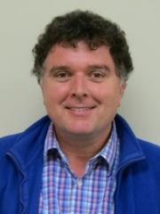
The Islands
Created by Michael Bulmer (University of Queensland)¹
Originally had one island (called “The Island”)
Now has three islands
We (Univ. of Minnesota, Division of Biostatistics) began using it in 2012
Collaborated with Dr. Bulmer to add features to facilitate medical studies (e.g. clinics, hospitals)
1. Bulmer, M., & Haladyn, J.K. (2011). Life on an Island.: A simulated population to support student projects in statistics. Technology Innovations in Statistics Education, 5(1). http://escholarship.org/uc/item/2q0740hv

Slide 7
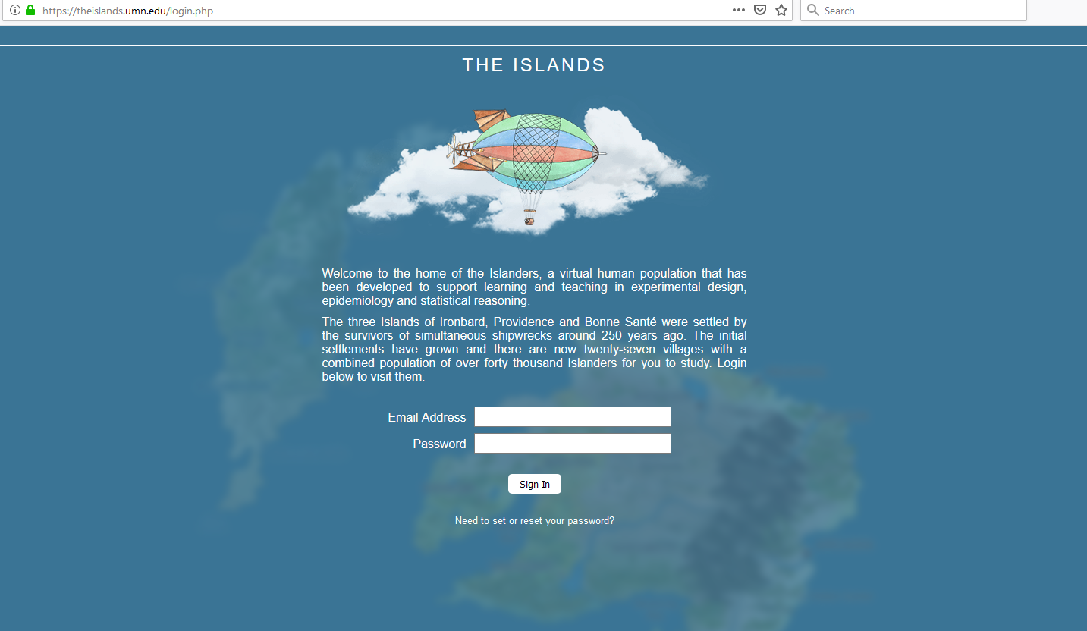
https://theislands.umn.edu/

Slide 8

Brief Video Tour of The Islands (5:13)

Slide 9
Islands Project Overview
Students work in groups to design, conduct, analyze, and report results of a study using the Islands.
Groups of ~2 to 6 students.
TAs serve as statistical consultants
Students present their findings in a research paper or poster session at the end of the course.
Notes:
The Island(s) project was first used in Biostatistics in PubH 6414, in Fall 2012, online and in-person.

Slide 10
Islands Project Structure and Timing
Week | Activity
1 | Islands exploration activity
2 | Journal of Island Studies activity
3 | Formulate research question
4 | Carry out pilot study
5 | Finalize study introduction and methods
6-7 | Data collection
8-9 | Data analysis (by TA/consultant, for the literacy class)
10-11 | Finalize study results and discussion
12-14 | Prepare presentation
15 | Presentations to the class
Notes:
This is the sequence that was used in PubH 6414 in-person, fall 2018. Other instructors sequence the projects slightly differently.

Slide 11


Islands Project Examples
Effects of Methamphetamine on Cognitive Function in Young Adults
RE-WINE: The Effect of Red Wine on Serotonin Release
YIKES! Youth Islander Knowledge Enhancement Study [Effect of Dextroamphetamine on Arithmetic Performance]
Effects of Smoking on Pulmonary Functioning and Exercise Tolerance
The DREAM Study: The Effect of Different Exercise Assignments on Melatonin
Notes:
Titles and images are from PubH 6414 Online Fall 2013 student projects.

Slide 12
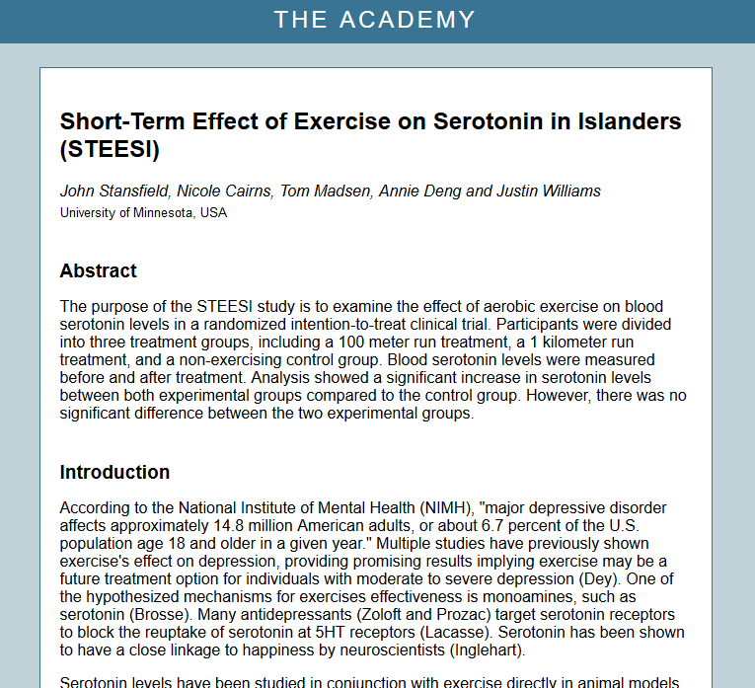
Notes:
This project report is available in the Journal of Island Studies, located in The Islands themselves, in the Academy.

Slide 13
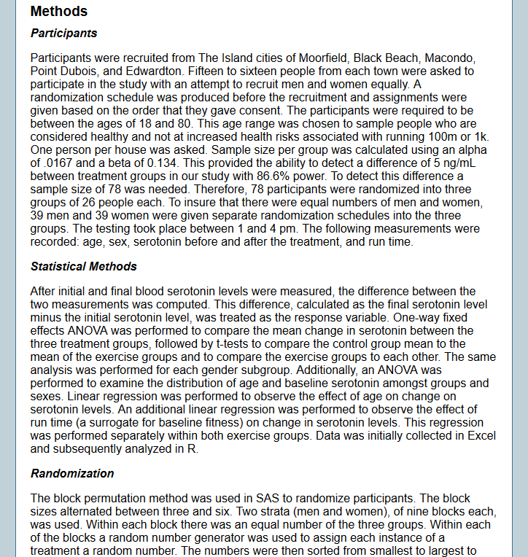

Slide 14
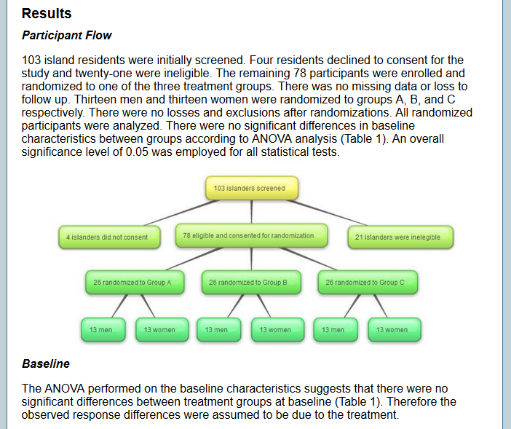

Slide 15
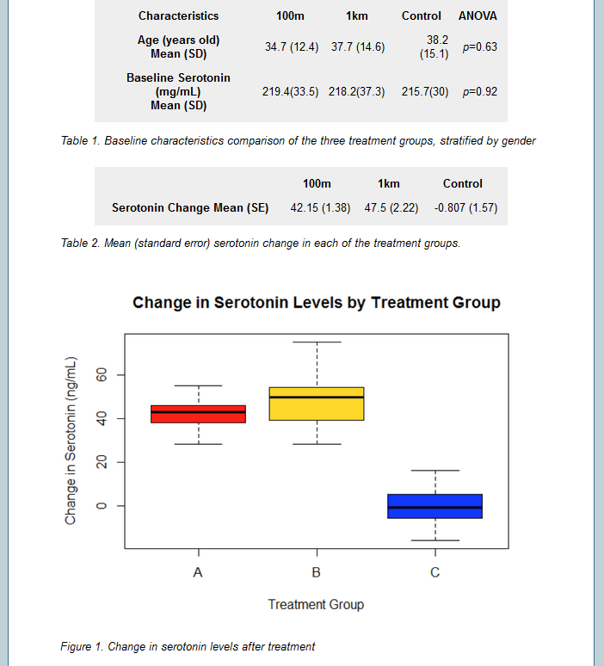

Slide 16
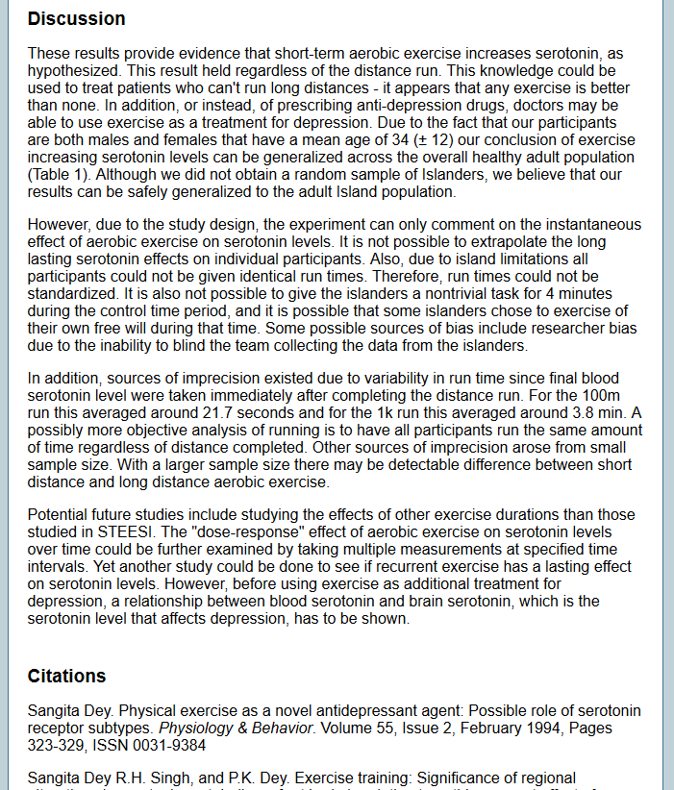

Slide 17
Benefits for Instructors
Addresses GAISE recommendations
Students collect and analyze their own real data to answer their own research question.
Improves teaching
Brings out issues students are having difficulty with (e.g. random sampling vs. random assignment).
Provides a built-in example to use in explanations.
Makes instructor-student relationship more collegial
Instructors/TAs become statistical collaborators. (Instructor doesn’t know ‘the answer’!)
Vastly increases the amount of non-homework-, non-exam-related interaction with students.

Slide 18
Benefits for Students
Apply the concepts and methods they learn in class to a “real” study.
Study design, sampling methods
Collecting and organizing (and cleaning!) data
Analysis and interpretation
Learn the necessity of teamwork to carry out a research study.
Notes:
Application and Collaboration were mentioned repeatedly as positives about the Island project in the student course evaluations.

Slide 19
Benefits for Students
Choose their unique research question.
Experience the entire research process.
See where statistics fits in a research study.
Gain experience presenting.
Forget that the Islanders are not real.
“The results from the pilot study indicated that the islanders did not behave like normal individuals. [Their behavior] disagreed with the literature.”
Notes:
The quote is from a PubH 6414 student project.

Slide 20
Learning Moments: Examples
Challenges in data collection:
Losing study participants when they were discharged from the hospital and can’t be found
Missing data when one student in the group forgets to take the measurements one day
Challenges with Islanders:
Sleep at night
Can refuse to consent to your study
Can tell lies (in the interview and survey features)
Challenges in data management and analysis:
There is no study database on the Islands for collecting all History information for study participants.
Nor is there any built-in analysis software.

Slide 21
Challenges
Island projects can be time intensive for the students (and for the TA/consultants and the instructors).
Students sometimes find group work challenging.
Students’ lack of knowledge of advanced methods (e.g. for correlated data) can constrain the types of studies they can do.

Slide 22
More information:
Minnesota’s mirror site:
https://theislands.umn.edu/
Instructor access (to Minnesota mirror site):
Email your name, email, institution and department to theislands@umn.edu to be added to the instructor list
Additional materials can be found in this Google Drive folder:
https://tinyurl.com/JSM2019-IslandsProject
Contents:
These slides
The Islands Exploration Activity worksheet
An Islands Project Overview
Notes:
Actual address for the folder:
https://drive.google.com/drive/folders/11BbfLS8h9GHgcvk0hdxAiVu9_YUobvjz?usp=sharing

Slide 23
Acknowledgements
UMN Biostatistics & Statistics instructors
Lynn Eberly, Rob Leduc, Greg Grandits, Susan Telke, Marta Shore, Barbara Kuzmak, Georgia Huang, Julian Wolfson
Collaboration with U. Queensland
Led by Susan Telke and Sara Hurley
Technical support
Sara Hurley (SPH Director of E-learning Services)
Chris Campbell, “Island(s) RA”

Slide 24

Questions?
brea0022@umn.edu

